Slide 1

Software
Go to One.iu.edu, login
Type in cloud storage
Select, link any accounts you wish to use
(e.g. Dropbox, Google Drive, OneDrive, etc.)
Go to IU Anyware (Googling it works)
Search for and “favorite” Stata (any version)
If using the first time, you will also need to download Citrix Viewer
Save the data files from Canvas to your linked folder so you can access in Stata.

Slide 2
Predictive Analytics for Business Strategy

Slide 3
A bit about myself
Labor and development economist
Business Analytics Consulting Workshop co-director
RPCV, former runner
Experience with housing
Long-term, short-term, hotel
Previously
Cornell Univ.
U of Illinois
Now, a bit about you…

Slide 4
Office hours - flexible
Officially, Mondays 8:30-9:30am
Office suite locked – email me if you plan to come
Unofficially, almost whenever
Email me with your question so I can:
Answer it
And/or set up a zoom meeting
And/or set up an in-person meeting
Bottom line – just reach out to me

Slide 5
Grading
Quizzes = 30%
2 on Fridays at home, between noon and 11:59pm (40 mins)**
Final Exam = 21%
February 22nd at home** (90 min, during class time)
Problem sets = 39% (in groups)
3 due on Sundays
Email me P.S. questions as a group after discussing
Participation (10%)
2 graded discussion forums, in class participation too

Slide 6
Participation
10% of your grade (in class, 2 discussions, hw group)
Meant to help, not hurt
Reach out for conflicts, health issues, etc.
Group work is not a free pass to let others work for you.
Reach out to me if any issues – I don’t anticipate any

Slide 7
Groups
Maximum 5 people per problem set group
You can join a group any time this week
I will randomly assign people to groups on Monday (1/16) for those who haven’t yet
This option is completely fine.

Slide 8
Programming – Stata for class
The focus of the course is causal inference, not coding.
Stata is chosen as the easiest way to allow students to perform all actions in 572, 579 without taking a separate class.
We’ll use it in class, but if you want to use R, python, etc., just make sure all in your group can.

Slide 9
Problem Sets
Done in groups, so you may want to coordinate if you wish to work in a different language.
Most questions will be more conceptual though.
Will be available ~13 days before due date.

Slide 10
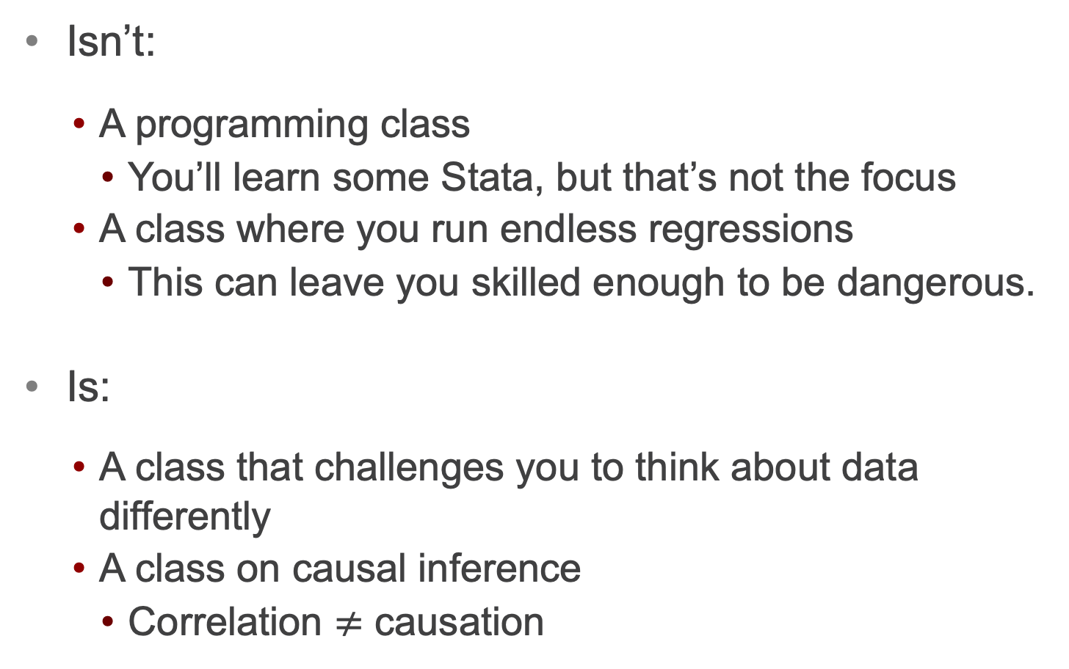
What this class is/isn’t
Isn’t:
A programming class
You’ll learn some Stata, but that’s not the focus
A class where you run endless regressions
This can leave you skilled enough to be dangerous.
Is:
A class that challenges you to think about data differently
A class on causal inference
Correlation $≠$ causation

Slide 11
By the end of this class, you should:
Have a general overview of what the course is about
Be able to identify different classifications of data sets.
Be able to import data into Stata and run a basic linear regression.

Slide 12
About G572

Slide 13
Causal inference
Causal inference refers to an intellectual discipline that considers the assumptions, study designs, and estimation strategies that allow researchers to draw causal conclusions based on data.*
Identifying the direct causal impact some X has on some Y.
*Not a def’n you need to know (but understand by end of the course).

Slide 14

Causation vs. Correlation

Slide 15
Causation vs. Correlation
*Note the date

Slide 16
Causation vs. Correlation
You have all surely heard and all surely said, “correlation does not imply causation.”
We all know and agree on this.
So why is an entire course on it necessary?

Slide 17
Saying it vs. practicing it
There are lots of cases where even those who would consider themselves to be qualified data analysts will fall into the trap of taking a correlation and reading a causal relationship into it.
You will be working with and/or overseeing many such individuals.

Slide 18
Avoiding the trap
As future data analysts, managers, etc., you need to have the tools to make sure you don’t assume a causal relationship unless one can be appropriately identified.
It’s not always as obvious as it may seem.

Slide 19
Correlation example
With your neighbors, discuss the following:
Suppose you are managing or consulting for a hotel in Chicago. You have daily sales data for every day in 2019, consisting of the price and quantity sold of standard rooms.
Do you expect there to be a positive or a negative correlation between quantity & price? Why?

Slide 20
“…in the right direction”
The cases that lull most people into mistakes often resemble the following:
Regression model (regress y on x1,… etc.)
Coefficients go “in the right direction.”
Because of this, we can imagine how x1 caused y to increase/decrease in this manner.
But would you invest $100m of your firm’s funds, hire/fire, etc., based on the belief that this is the causal impact X1 has on Y?

Slide 21
Software – how to access Stata
Go to One.iu.edu, login
Type in cloud storage
Select, link any accounts you wish to use
(e.g. Dropbox, Google Drive, OneDrive, etc.)
Go to IU Anyware (Googling it works)
Search for and “favorite” Stata (any version)
If using the first time, you will also need to download Citrix Viewer
Save the data files from Canvas to your linked folder so you can access them in Stata.

Slide 22
Let’s do a couple simple examples
IU Anyware -> Stata
File -> Import csv/xlsx
(opening a file only works if it’s a .dta or .do file)
Open the Class 1.1.xlsx file
Open one sheet at a time.
**If first row are variable names, click “import first row as variable names” box

Slide 23
Quantity sold and price
Reg the quantity sold variable on the price variable.
You can type it or click it.
Linear regression command is simply:
reg y x
We’ll discuss this more later, but
y = outcome variable
x = independent variable
The output will simply tell us how x and y move together.

Slide 24
Which of the following represent a causal relationship?
Coefficient on Price of Ads
Coefficient on Price of Shoes
Neither
Both
Not enough information to tell
Notes:
Neither – (if this is observational data) – more on hits later in the semester

Slide 25
Data Uses in Business

Slide 26
Data
What is/are data?
Data are a collection of information
Essentially everything you observe can be characterized as data
Business, policy, sports, etc. have transitioned to a world that demands “evidence-based” decisions
And data are the evidence
Notes:
Data are plural…Latin.

Slide 27
Predictive Analytics/Business Analytics
What is business analytics?
The use of data analysis to aid in business decision-making
Business analytics is a HUGE field
Econometrics
Data mining
Predictive analytics
What is predictive analytics?
Any use of data analysis designed to form predictions about future, or unknown, events or outcomes

Slide 28
Predictive Analytics/Business Analytics
How do we use predictive analytics?
Fraud detection
Predict/identify false insurance claim
Predict/identify spam call/text
Risk management
Predict portfolio performance
Business strategy
Predict online purchases

Slide 29
Predictive Analytics/Business Strategy
What has changed? Why has business analytics become a “big deal?”
We now have lots of data?
We now have lots of computing power?
We have new models?
Notes:
NOPE – we had all those things for a while now. The big difference is that decision-makers are largely willing to base decisions on what the data say.

Slide 30
Types of data sets

Slide 31
Data Types
Time component of units of observation often gets special attention, as it can dictate methods
Four main types of data
Cross-sectional
Pooled cross-sectional
Time series
Panel

Slide 32
Data Types
Cross-sectional:
No variation in time
Pooled cross-sectional (aka repeated cross-sectional)
Essentially, multiple, different cross-sections taken at different times
Time series
Variation is only in time
Panel
Same cross-sectional units at different points in time

Slide 33
Types of data sets
On the following slides, there are images meant to be analogies for the following. See if you can match them to these data types.
Cross-section
Repeated cross-section (aka pooled cross-section)
Time series
Panel data

Slide 34




*Types of data
Cross-section,
Repeated cross-section (pooled cross-section)
Time series
Panel
A __________ of economists

Slide 35





Types of data
Cross-section,
Repeated cross-section (pooled cross-section)
Time series
Panel
_________________ of economists
$$t=1$$
$$t=2$$

Slide 36




Types of data
Cross-section,
Repeated cross-section (pooled cross-section)
Time series
Panel
A _________________ of an economist
$$t=1$$
$$t=2$$
$$…$$
$$t=T$$

Slide 37



Types of data
Cross-section,
Repeated cross-section (pooled cross-section)
Time series
Panel
$$t=1$$
$$t=2$$
$$…$$
_________________ of economists

Slide 38
Data Generating Process
Once you understand the data type, the next question:
How did these data come about?
Why do we care?
Thinking of how the data were produced will ultimately guide proper analysis and particularly interpretation.
How the data came about is called the data generating process (DGP)

Slide 39
Data Generating Process
The data generating process is not something we generally ever know.
Physicists try to uncover the DGP of the universe.
Economists try to uncover the DGP of how humans allocate scarce resources.
Neither knows the true DGP.

Slide 40
Model
A model can be thought of as our best guess of/attempt at the DGP.
We often have a pretty good idea of what things directly affect our outcome variable (Y).
Unfortunately, we often do not have data on all of them and may not be aware of others. Those are in (U) -> unobservables.
Will contribute to “messiness” I’ll discuss in a moment.

Slide 41
Major Topics
of the course

Slide 42
Active vs. Passive Prediction
We’ll go into it later, but most people don’t know the difference between what the text calls active vs. passive prediction.
Passive requires only correlation.
Active requires identifying a causal impact.

Slide 43
The Gold Standard: RCT
The gold standard is the randomized, controlled trial.
Data from these is known as experimental data.
Makes our life easier, but not all that common.
Pharma trials, large companies do have some though.

Slide 44
Experimental vs. Observational
As we just mentioned, data from an RCT is experimental data.
Non-experimental data, which I often refer to as “real world data” is called observational data.
Prices/incentives have not been randomly assigned.
They are determined by interactions of people and firms who are trying to optimize (do their best).

Slide 45
The real world is messy
When trying to identify causal impact of X on Y, with
RCT (experimental) data our life is easy.
Real world (observational) data, it can get messy.
Why is it easy in the RCT?
Consider Pfizer/BioNTech COVID vaccine trial:
How should the control and treatment groups look?
Any differences?

Slide 46
Confounding factors
In an RCT, we can set it up so just one variable changes (e.g. vaccine/placebo).
In observational data, lots of variables are changing.
Some of those mess up our ability to identify the causal impact of X on Y.
We call those confounding factors.

Slide 47
Confounding factors
In observational data, lots of variables are changing.
Some of those mess up our ability to identify the causal impact of X on Y.
We call those confounding factors.
Generally, we don’t have data on them.
This is what makes things messy.

Slide 48
A systematic approach
After teaching this a handful of times, I became frustrated with the lack of a repeatable approach to identifying confounding factors (the root of our causal inference problem).
I’ve developed a simple (repeatable) and systematic approach to identifying confounding factors.
Causal inference can get messy, my job is to help you see how to make it less so (on a consistent basis).

Slide 49
Correlation will be key
For us to successfully implement the (fairly simple) systematic approach, it will be really important for us to have a solid foundation in what it means for two variables to be correlated.
This may seem obvious with scatterplots, but maybe less so with time series.
And we won’t usually have either.
Just as you didn’t in the price & quantity of hotel rooms in Chicago question.

Slide 50
Correlation Examples
Correlation
Strong/weak
pos/neg/zero

Slide 51
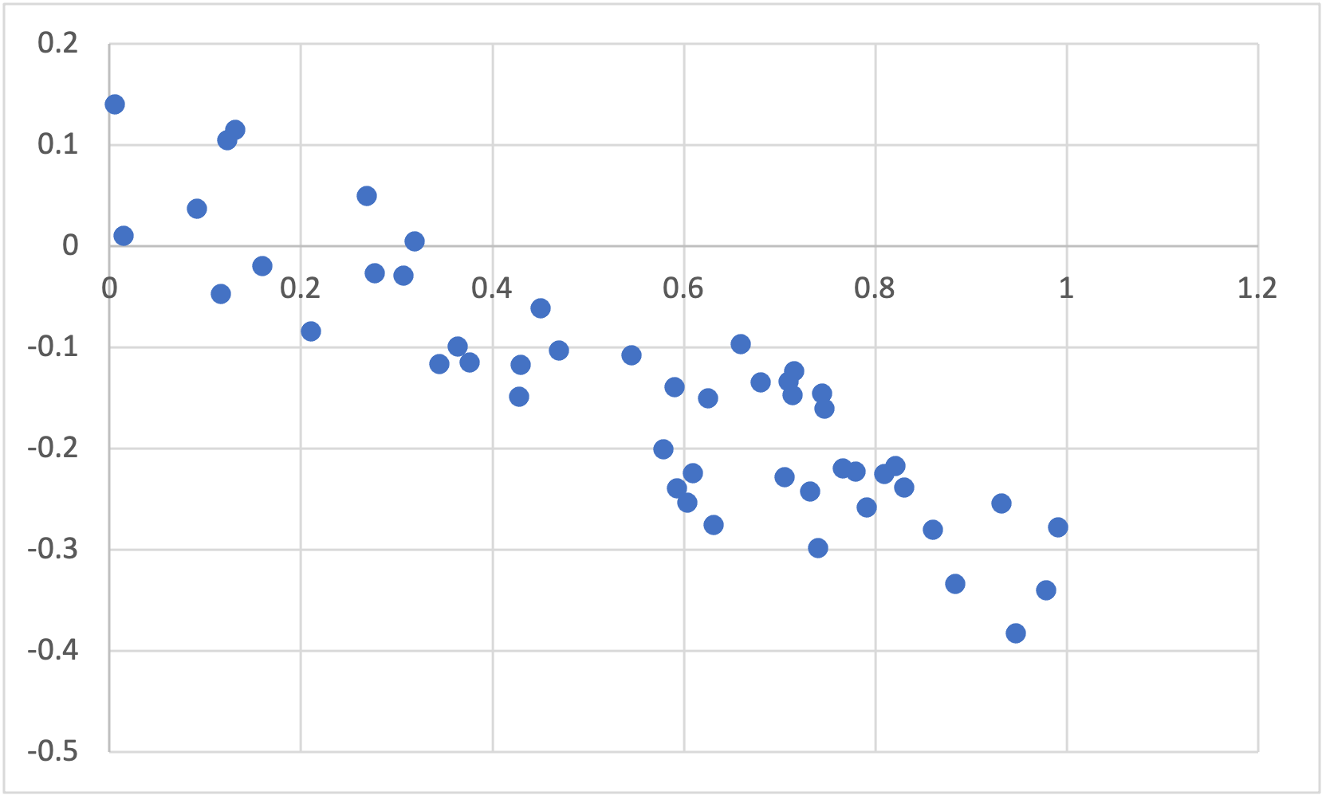
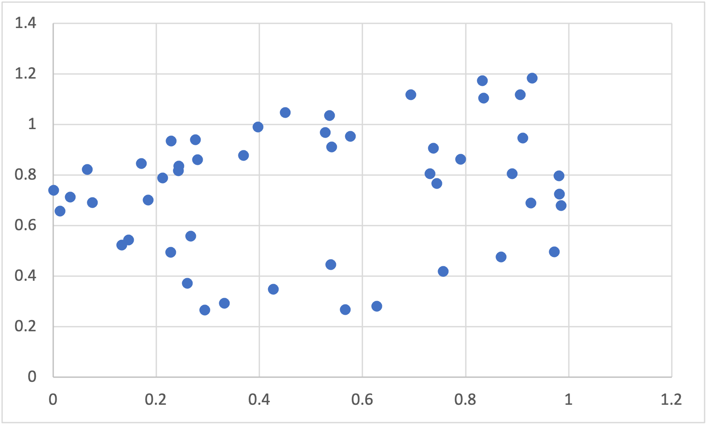
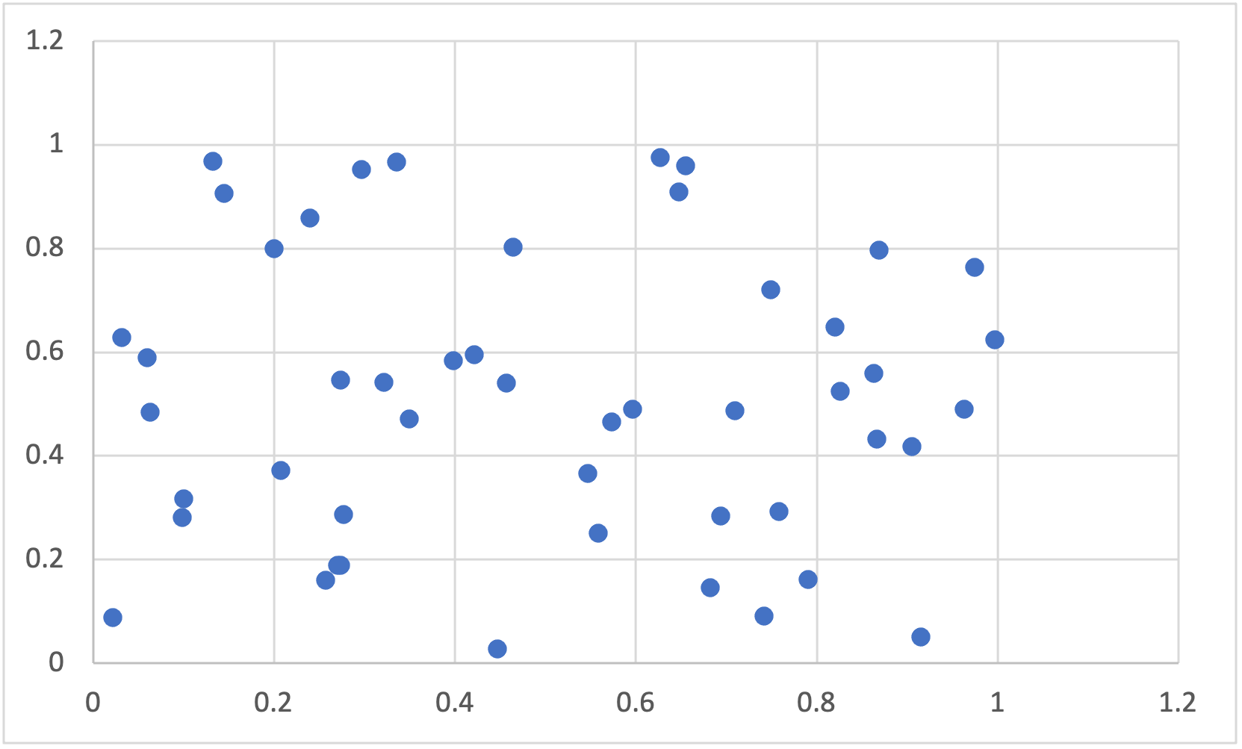
Strong/weak? Pos/neg/~zero?

Slide 52
Scatterplots we can eyeball
But I’d encourage you to use the following:
Two variables are positively correlated if:
When one variable is above (below) its mean, the other variable is above (below) its mean.
Let’s see how we do with time series.

Slide 53
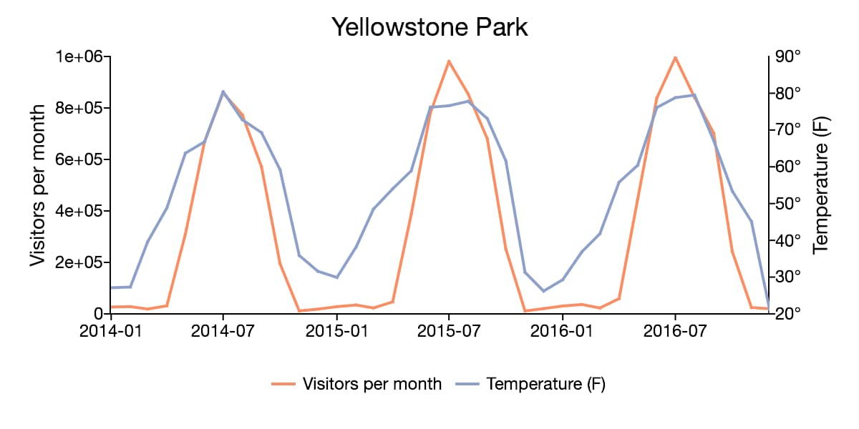
Temp., Yellowstone visitors

Slide 54
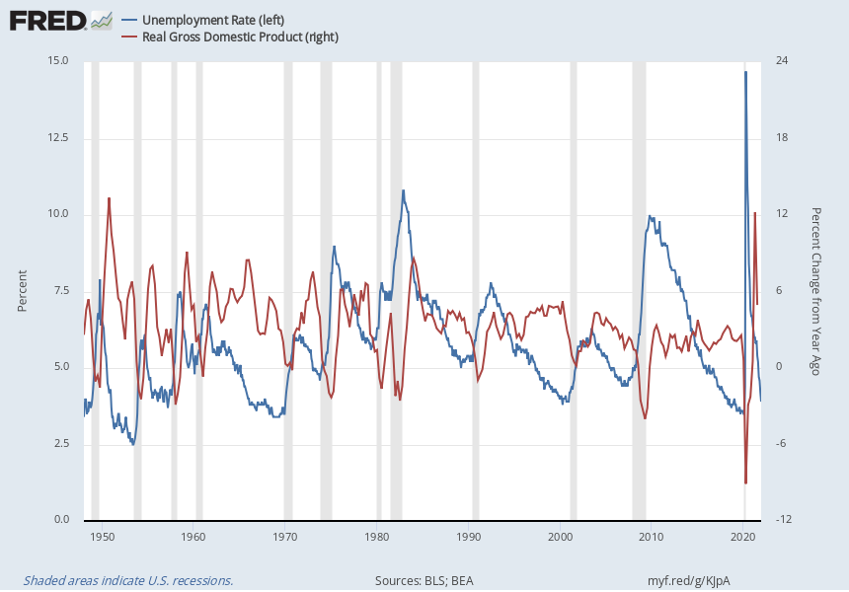
Unemployment, GDP Growth

Slide 55
Announcements/Reminders
Follow instructions on first slide to make sure you can utilize data using Stata via IU Anyware
Join a problem set group.
I will randomly assign Monday (1/16) for those who haven’t.
Email me with any questions or meeting requests: emcderm@iu.edu

